Slide 1

PROJECT NAME : online Quiz apln
Developed BY Manoj Kumar K

Slide 2
Github link
https://github.com/Mskmanojkumar/E-Com_Sporty_Shoes

Slide 3
Overview
This Project give access to admin to login into Website. Sporty Shoes is a company that manufactures and sells sports shoes. They have a walk-in store, and now, they wish to launch their e-commerce portal sportyshoes.com.

Slide 4
Flow Chart
Start
Quiz(default selected)
B
REVIEW
A

Slide 5
C
Check Answered Questions
Show Not answered
We can move to the unanswered Question
B
Submit
D

Slide 6
D
Checking all Question and Answers
Show all Correct Answered
Show the result of All question

Slide 7
Documentation
Tools and Programming Language used in this Project
Angular
Git hub
TypeScript

Slide 8
Documentation
Tools and Programming Language used in this Project
JSON
CSS
HTML

Slide 9
Documentation
Tools and Programming Language used in this Project
java script
Vs. Code

Slide 10

Sprint Planning
Task Name | Start Date | End Date | Estimated Points | Pending | Completed | Status | PRIORITY
Designing Web pages with quiz Questions | 10-Oct-21 | 10-Oct-21 | 3 points |  | 3 points | Completed | MEDIUM
Designing Web pages using CSS and Bootstrap | 11-Oct-21 | 11-Oct-21 | 6 points |  | 6 points | Completed | HIGH
Creating multiple button and Function | 12-Oct-21 | 12-Oct-21 | 5 points |  | 5 points | Completed | MEDIUM
Adding Checking points to Submit and Review | 13-Oct-21 | 13-Oct-21 | 9 points |  | 9 points | Completed | HIGH
Connecting Front end to JSON Format | 14-Oct-21 | 15-Oct-21 | 7 points |  | 7 points | Completed | HIGH
Testing | 16-Oct-21 | 16-Oct-21 | 8 points |  | 8 points | Completed | MEDIUM

Slide 11

Core Concept and algorithm
VS Code
JSON-SERVER
Bootstrap
Form Module
Java Script
Pagination
Timer

Slide 12
How to execute
Run Home.java Program file Location (\Online-Quiz-application\src)

Slide 13
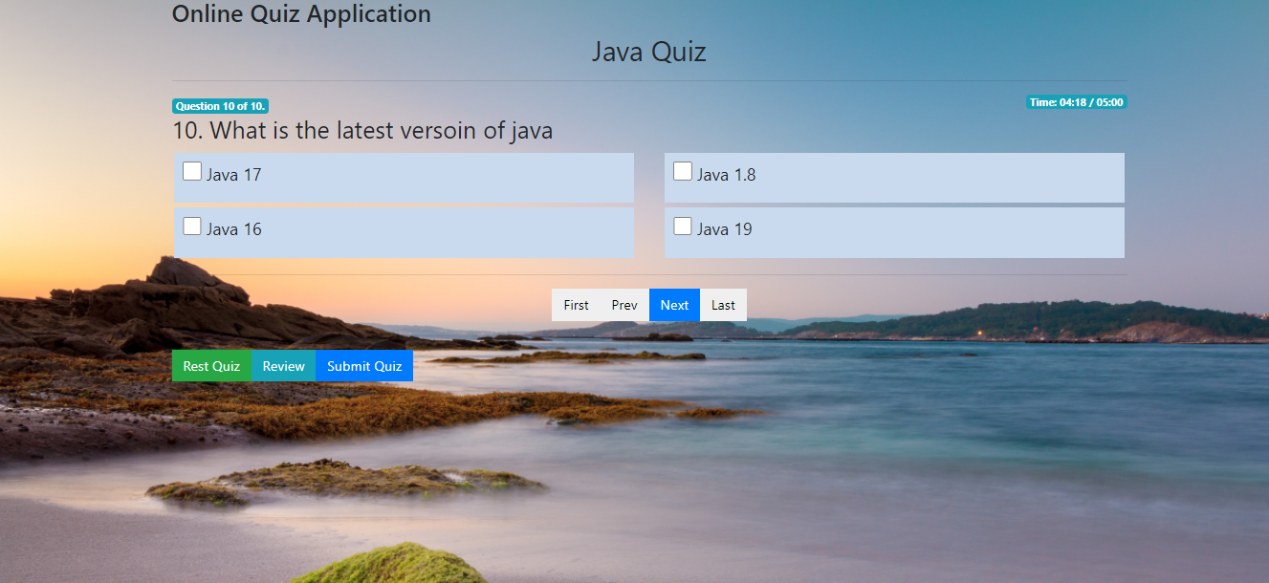
Sample Output 1

Slide 14
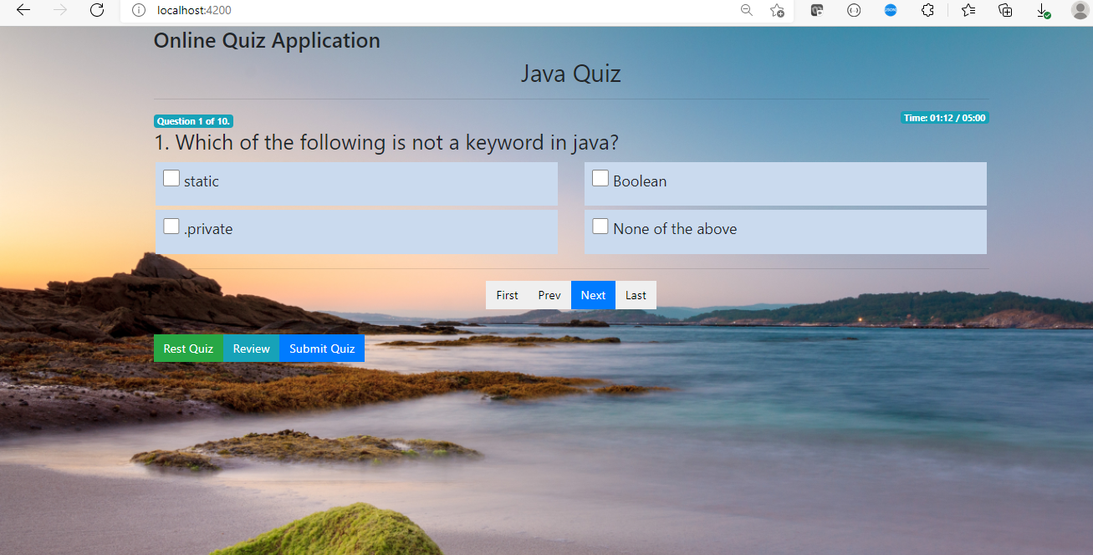
Sample Output 2

Slide 15
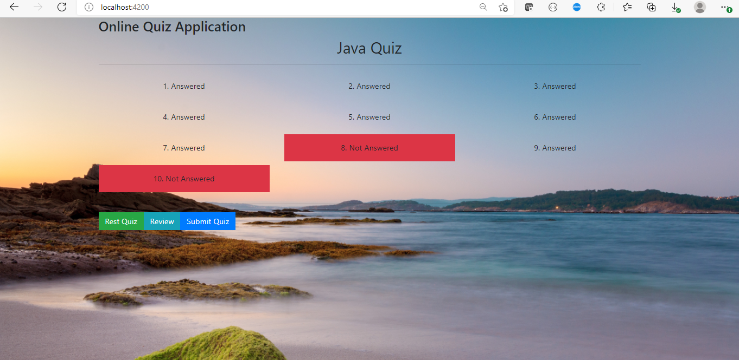
Sample Output 2

Slide 16
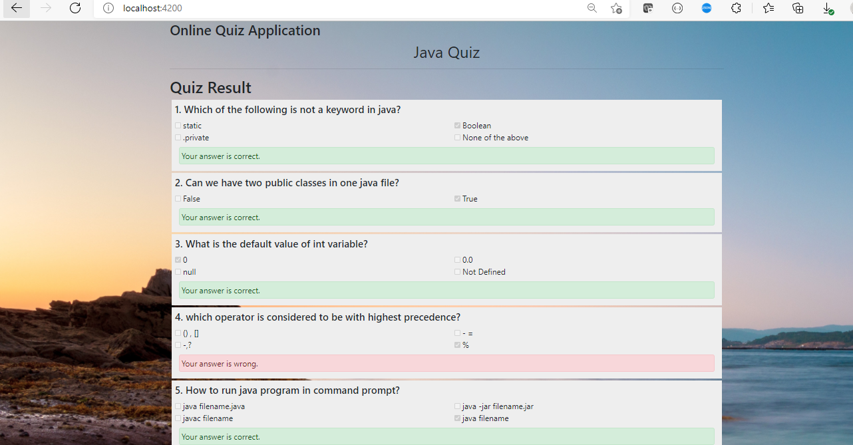
Sample Output 2

Slide 17
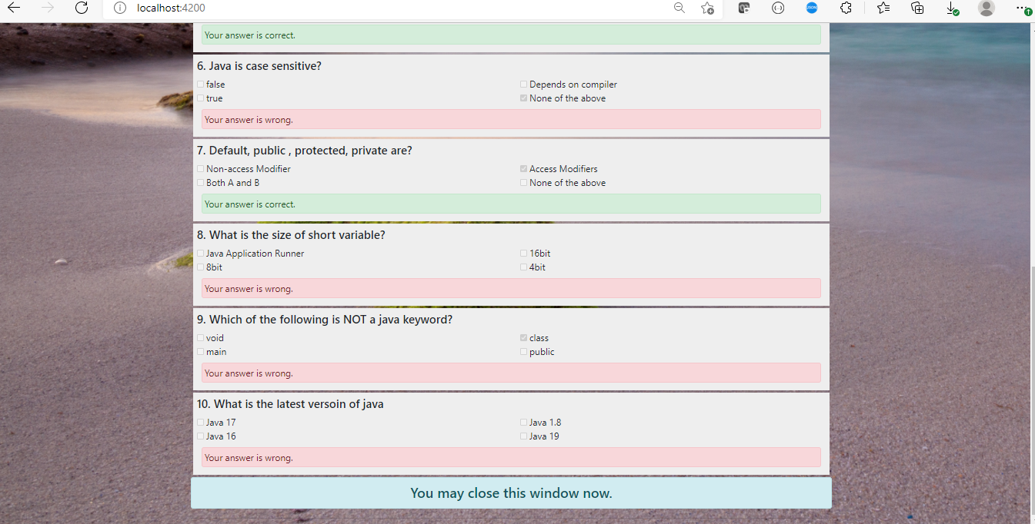
Sample Output 2

Slide 18
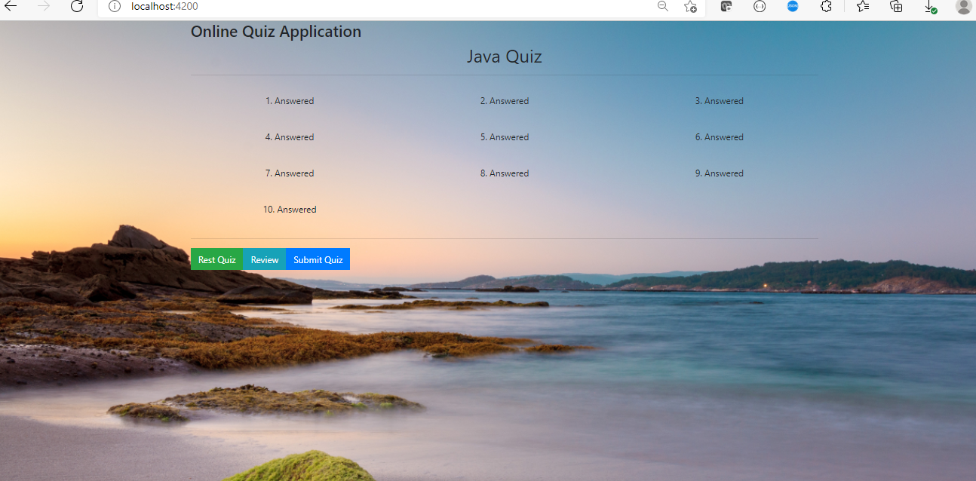
Sample Output 2

Slide 19
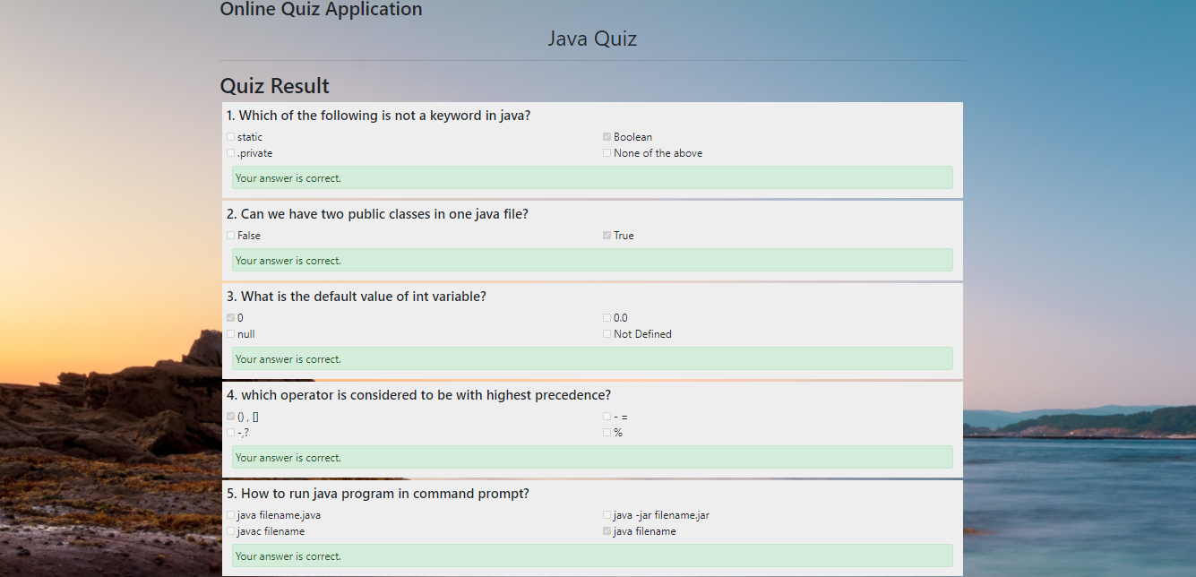
Sample Output 2

Slide 20
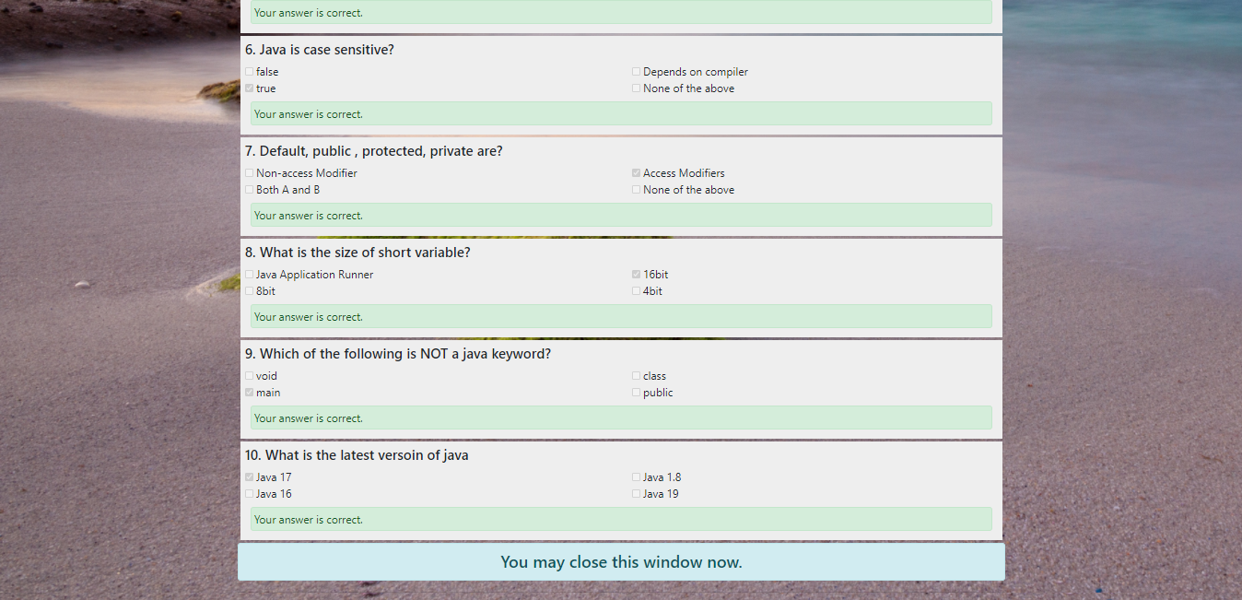
Sample Output 2

Slide 21

Thank You
Name : Manoj Kumar k
Phone no: 8667695691
manojkumar720066@Gmail.com

